Slide 1
Communication Kit
Net-Zero Industries Award 2024

Slide 2
CONTENT SUMMARY
About Net-Zero Industries Mission (NIM)
About Mission Innovation (MI)
Amplifying NIM on Social Media
Suggested Copy for Posts, Award Banner
Hashtags and Tags
Suggested Newsletter Post
How NIM is Taking Action

Slide 3
About the Net-Zero Industries Mission
The Net-Zero Industries Mission (NIM) launched in 2022 and is the first ever global innovation coalition with the goal of developing and demonstrating cost-competitive solutions to create a net-zero industries future. The Mission is led by Austria and Australia, in collaboration with Canada, China, the European Commission, Finland, Germany, the Republic of Korea, the UK and the USA, and aims to deliver at least 50 large-scale demonstration projects around the world by 2030.
The NIM members alone are responsible for over 50% of global industrial emissions and invested around USD $13.45B into research, development and demonstration in 2021. Since its launch, NIM has released an innovation roadmap titled 'Towards Net-Zero Industries', as well as the recent Action Plan which outlines the actions needed to reach Mission goals.

Slide 4
About Mission Innovation
Mission Innovation (MI) is a global initiative to catalyse action and investment in research, development and demonstration to make clean energy affordable, attractive and accessible to all within this decade. This will accelerate progress towards the Paris Agreement goals and pathways to Net-Zero. MI brings together 24 governments in an agile and flexible way, focusing on a small number of high impact initiatives. These initiatives – called Missions - are harnessing the power of the international organisations, major companies, investors, incubators and innovators to deliver on their objectives.

Slide 5
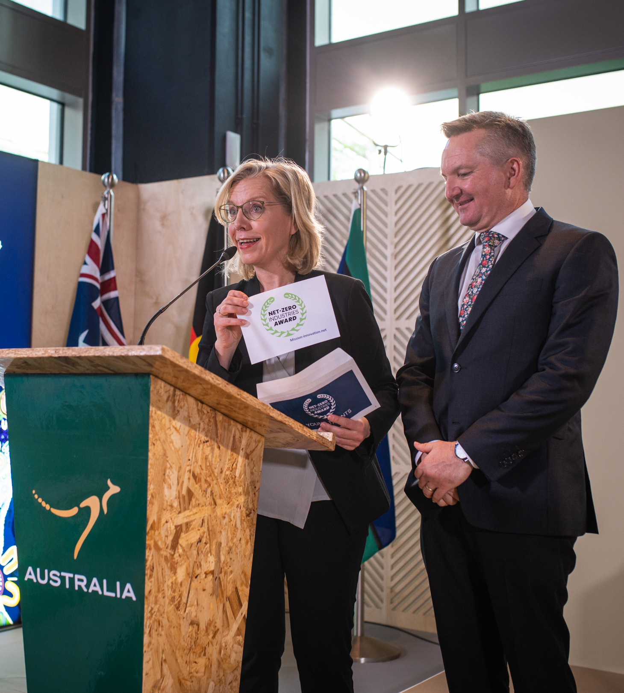
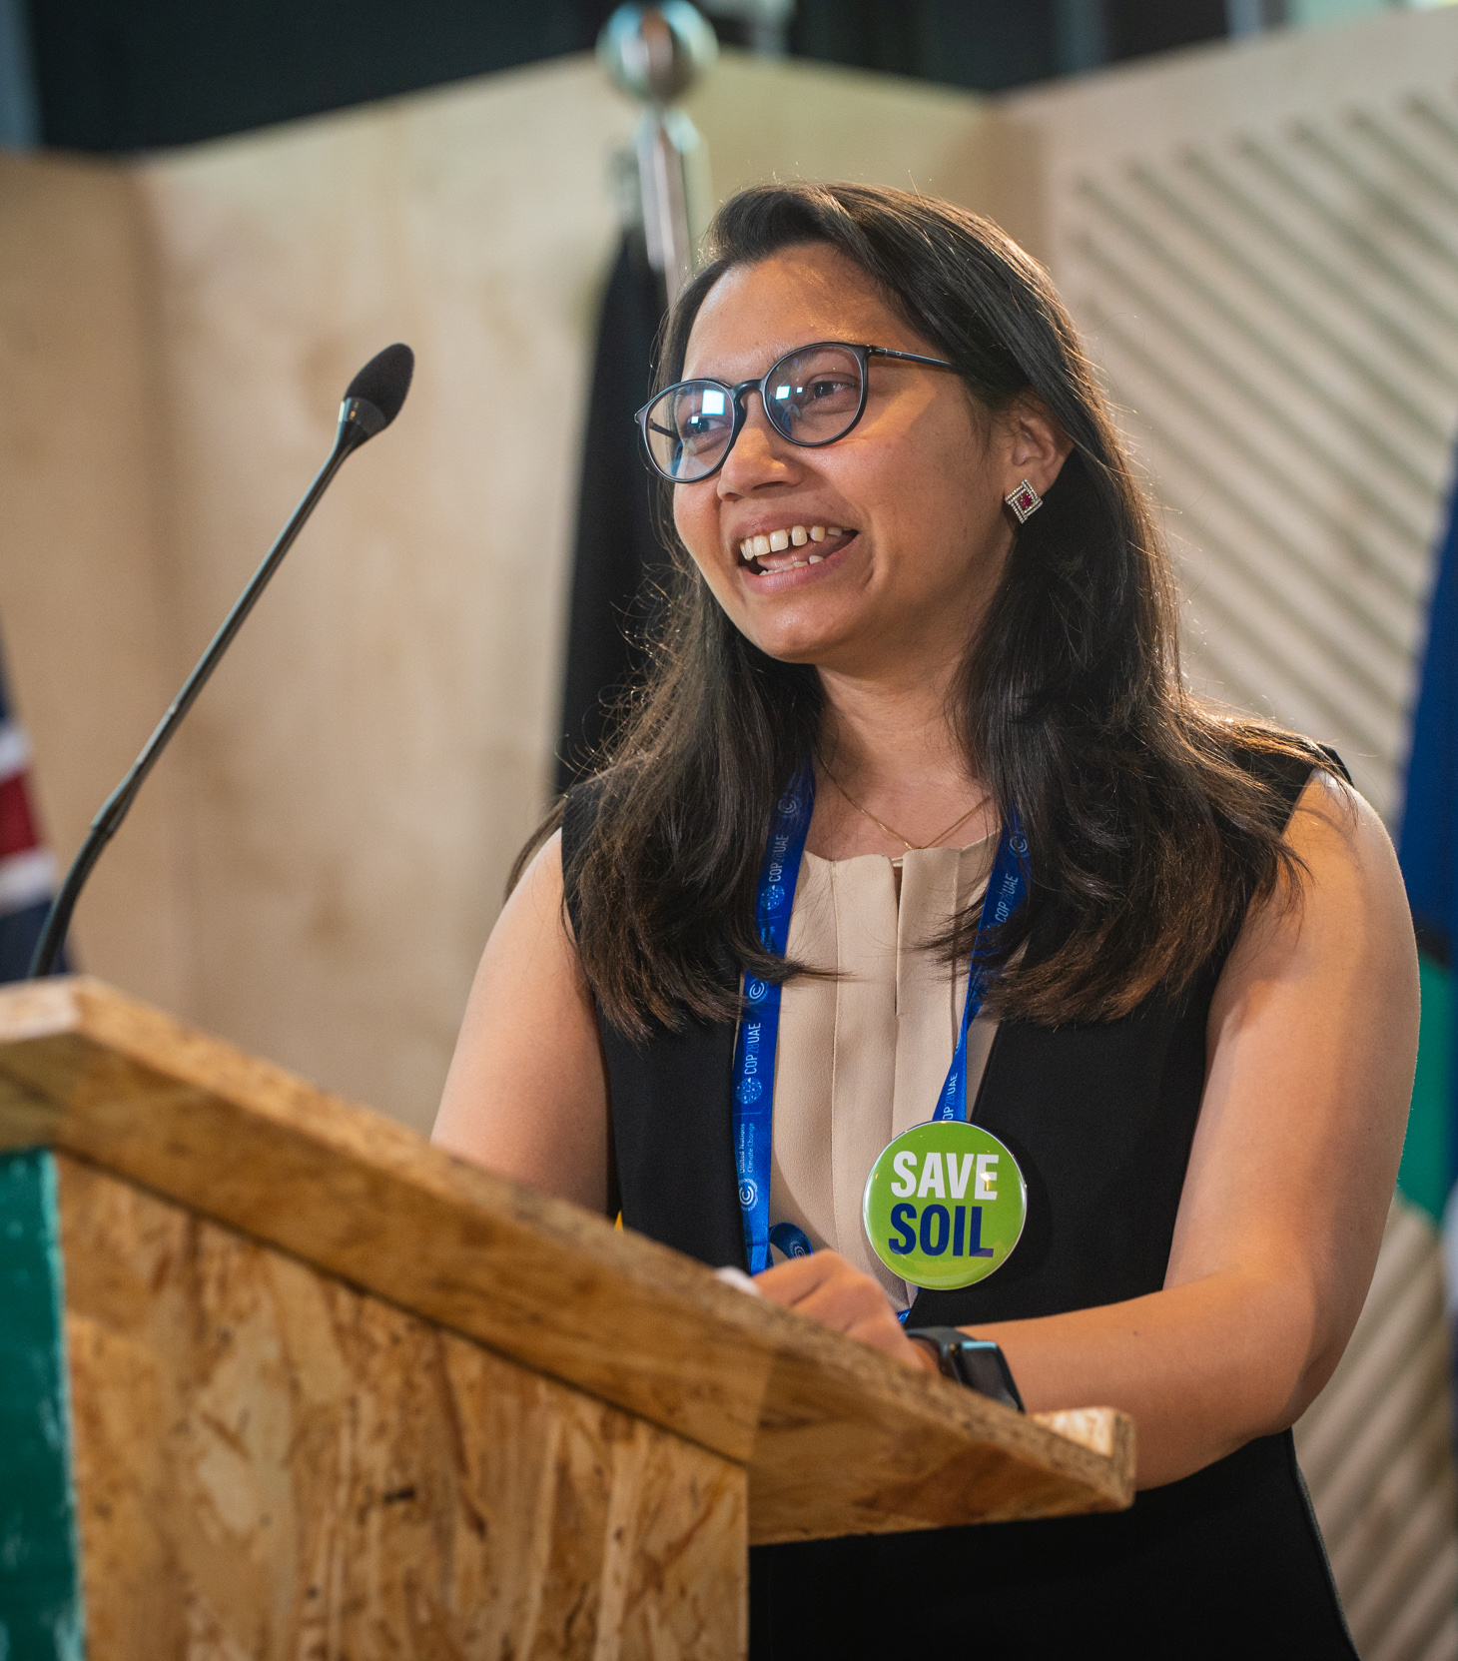
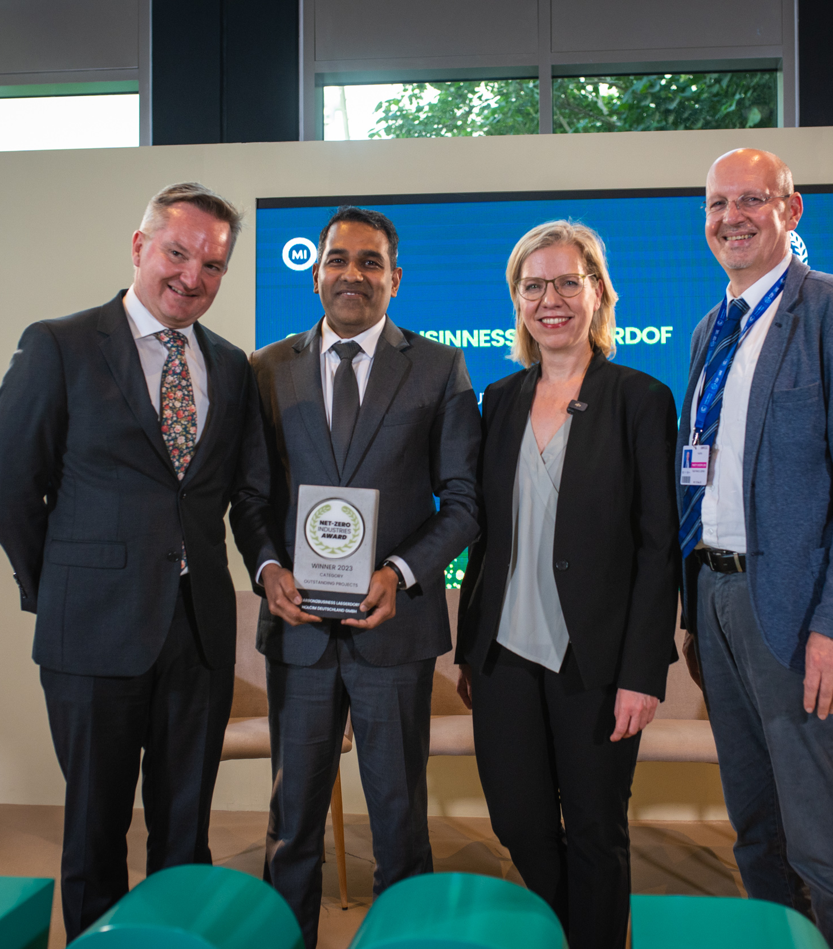
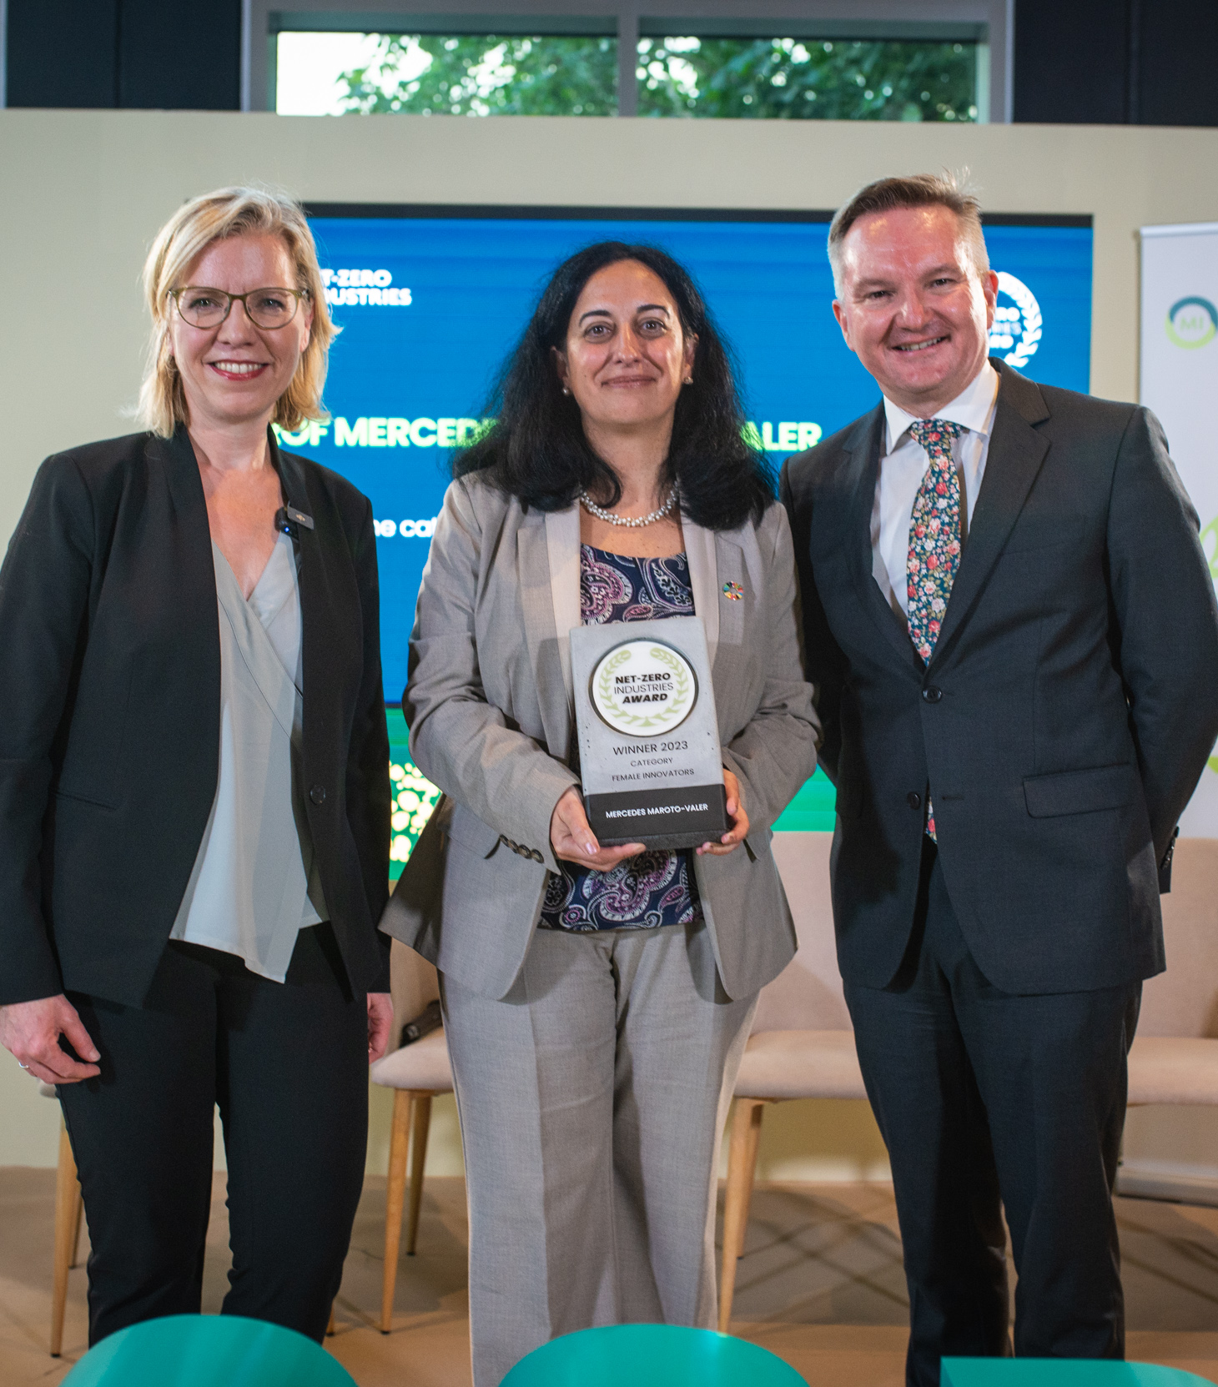
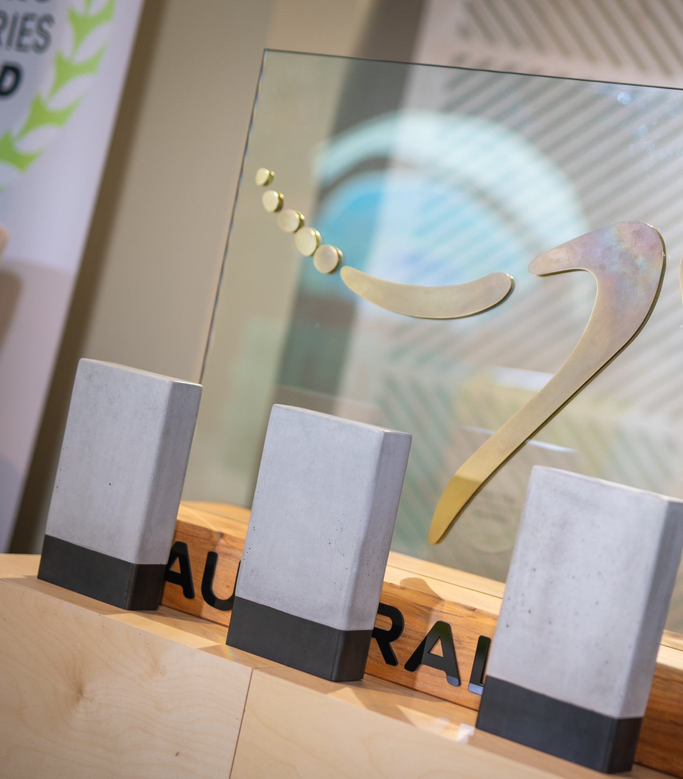
2023
Nearly 70 submissions from 16 countries
Award Ceremony @ COP28 in Dubai
Prestigious winners in all 3 categories:
Outstanding Projects Carbon2Business Laegerdorf, Holcim Germany GmbH
Female Innovators Professor Mercedes Maroto-Valer, IDRIC
Young Talents Dr Suneeti Purohit, CSIRO

Slide 6
Net-Zero Industries Award 2024
The 2024 Net-Zero Industries Award celebrates the world’s BEST innovations in GLOBAL industrial decarbonisation EFFORTS as the first global competition for outstanding work on industrial transformation. We are excited to announce the second edition of the award. The awards will be presented in three categories:
(1) Outstanding projects
(2) Young Talents and
(3) Female Innovators
Special prize for international advancement in industrial decarbonisation
Submission deadline: 1st of Sep. 2024, 24:00 CEST

Slide 7
Award banner 1

Slide 8
Award banner 2

Slide 9
Amplifying NIM's activities on Social Media
By promoting Net-Zero Industries Mission’s activities you are directly supporting the impact of NIM. We warmly invite you to post from your Social Media accounts and get the word out – feel free to use the suggested posts in the next slides for this. By engaging (liking, commenting, reposting) with Net-Zero Industries Award’s posts you are also hugely supporting the Net-Zero Industries Mission.

Slide 10
Suggested Copy for Posts
🏆 The Net-Zero Industries Award is back for 2024! 🌏 This global competition for outstanding contributions to #IndustrialDecarbonisation has 3 award categories: ✨ Outstanding Projects ✨ Female Innovators ✨ Young Talents ⭐And this year, there is a new prize. The best submission from the global south across all categories will be awarded the Prize for International Advancement in Industrial Decarbonisation. 👉 Learn more and apply today: NET-ZERO INDUSTRIES MISSION - Mission Innovation (mission-innovation.net) #NIMAward2024 #NIM #NetZero #Colloboration #Research
@Mission Innovation @NIM - The Net-Zero Industries Mission
🌟 Exciting News! The Net-Zero Industries Award is back for 2024! We’re thrilled to announce the return of this global competition dedicated to recognising outstanding contributions to #IndustrialDecarbonisation. This year, @NIM - The Net-Zero Industries Mission is highlighting: 🏆 Outstanding Projects 👩‍🔬 Female Innovators 🌱 Young Talents
⭐And this year, there is a new prize. The best submission from the global south across all categories will be awarded the Prize for International Advancement in Industrial Decarbonisation. 👉 Apply today!: NET-ZERO INDUSTRIES MISSION - Mission Innovation (mission-innovation.net) #NIMAward2024 #NIM #NetZero #Colloboration #Research
@Mission Innovation
Please modify the text according to your writing style.
Add some personal thoughts and takeaways.

Slide 11
Hashtags & Tags
The Net-Zero Industries Mission has a profile on LinkedIn: https://www.linkedin.com/company/nim-the-net-zero-industries-mission
Link your posts and contributions to NIM and MI profiles using @NIM - The Net-Zero Industries Mission and @Mission Innovation and feel free to use our hashtags so that the relevant community receives your information:
#NIMAward2024 #NetZero #NIMAward #NIM #SustainableSolutions #ClimateAction #Innovation #WomenInSTEM #YoungLeaders #IndustrialDecarbonisation #HeavyIndustry

Slide 12
Suggested Copy for Newsletter
Net-Zero Industries Award 2024 - Global Competition Launched
Outstanding projects and solutions, Young Talentsand and Female Innovators – in these three categories, the Net-Zero Industries Award 2024 will once again recognise extraordinary projects and commitments in the field of industrial decarbonisation. The award is presented by the Net-Zero Industries Mission, a cross-country, governmental, and industry collaboration aimed at advancing and accelerating the adoption of decarbonisation technologies in energy-intensive industries.
It is currently planned to hold the award ceremony at the 2024 United Nations Climate Change Conference (COP29) 11– 22 November in Baku, Azerbaijan. Submission deadline: September 1, 2024, 24:00 CEST
Submit Now: NET-ZERO INDUSTRIES MISSION - Mission Innovation (mission-innovation.net)

Slide 13
Contact Net-Zero Industries Mission, Thomas Natiesta T +43 50550-6041 Netzeroindustriesaward@ait.ac.at

